Slide 1

MMLA END TERM
VISHAL GARG
FT224092

Slide 2
PRINICPAL COMPONENT ANALYSIS (PCA)
Principal Component Analysis or PCA is a statistical procedure or dimension reduction technique that helps us to reduce the dimensionality of dataset, thereby increasing interpretability but at the same time minimizing information loss.
The main pre-requisite to run PCA is that the variables should be highly correlated.
PCA basically searches for a linear combination of variables so that we can extract maximum variance from the variables.
The ideal number of components are obtained with the help of Scree Plot.

Slide 3
DATASET DESCRIPTION
The dataset has a total of 7 columns with one unique identifier symbol, 5 predictor variables which are market_cap, cash_and_marketable, totalenterprisevalue, revenues and ebitda. The dependent or target variable is profit.
The dataset looks to be data about different companies and their financials in the capital market.
Dataset has a total of 25 records.
There are no null values in the dataset.

Slide 4
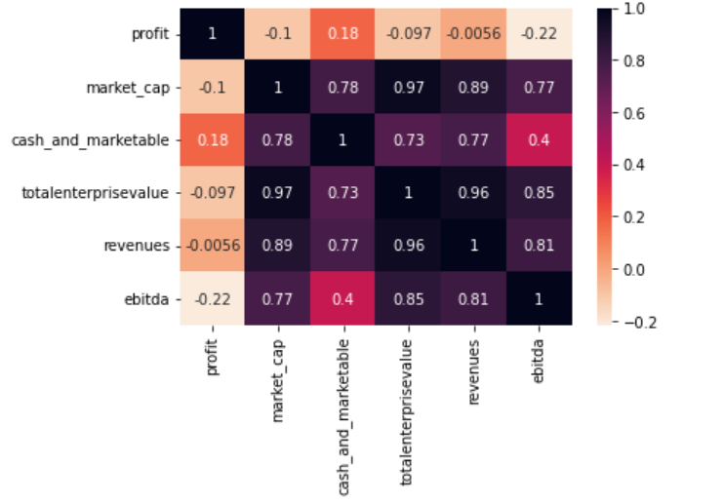
DATA EXPLORATION
On checking the correlation between the variables with the help of a heatmap, we can see that the values turn out to be high which shows that there is high correlation between them.
High correlation is visible from the dark colored values in our heatmap given alongside.

Slide 5
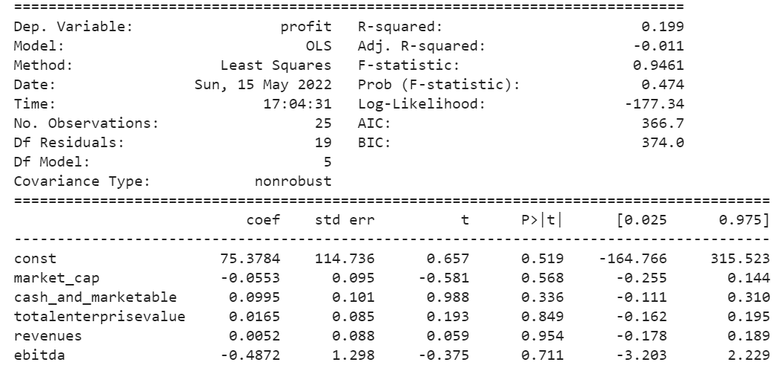
LINEAR REGRESSION
We run linear regression with our predictor variables and target variable as profit in order to identify how our model is performing with the original predictor variables.
On running the model, we obtain an adjusted R-Squared value of -0.011, which obviously is very poor. The model we have created has very poor predictive power. Also, if we look at our ANOVA table and can see that none of the predictor variables are significant given that our probability of error is 5%.

Slide 6
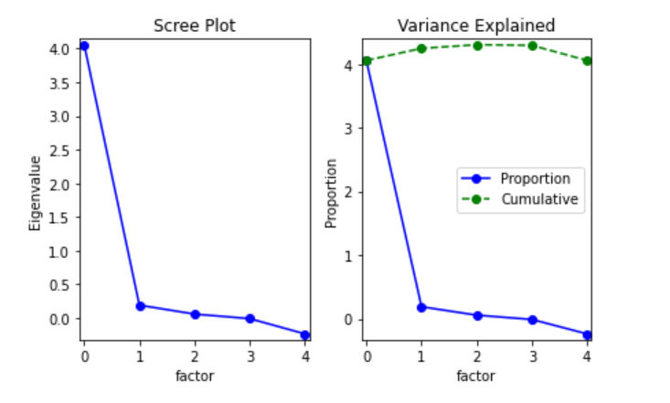
SCREE PLOT
After identifying that there is high correlation between our predictor variables, we’ll have to run PCA to identify Principal Components. In order to identify the correct number of components to be created, we’ll have to obtain scree plot. From the scree plot obtained, we can see that there should be 2 Principal Components i.e. PC0 and PC1.

Slide 7
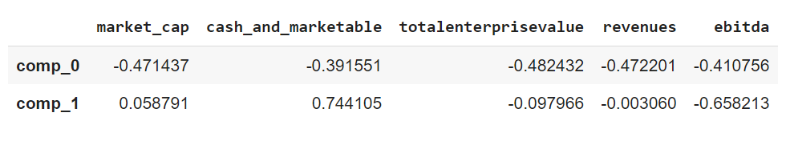
MODEL SELECTION
Now, we’ll run PCA with 2 components which we obtained from scree plot.
The output obtained is given alongside and we can clearly see 2 things from that:
market_cap, totalenterprisevalue, and revenues are loading high on PC0.
cash_marketable and ebitda are loading high on PC1.

Slide 8
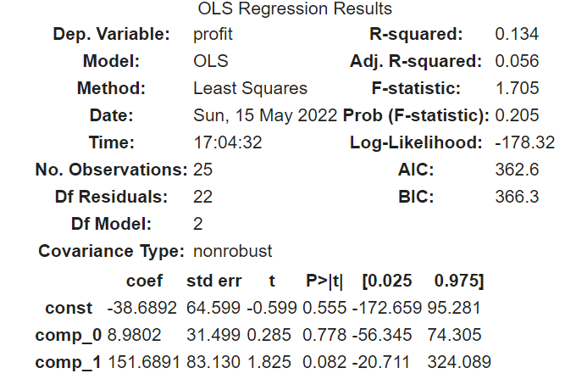
FINAL INSIGHTS/ RECOMMENDATIONS
After obtaining our Principal Components, we’ll again run our model with our obtained components as predictor variables and profit as target variable.
We can see that the Adjusted R-squared values obtained is 5.6%, which is again very poor. This shows that even after creating components, our model is performing poorly and its predictive power is still very low.
On top of that, we can see from the ANOVA table that the predictor variable (components) are insignificant. So, we can say that the model we have created can be discarded and shouldn’t be used for any kind of prediction.
All of this could be because of the size of the dataset as we only have 25 records. We can try obtaining more data and then re-running the model.

Slide 9
MULTIDIMENSIONAL SCALING (MDS)
Multidimensional Scaling is the method of visual representation of distances or dissimilarities between set of objects. This helps us to reduce the dimension of multidimensional data into 2-D which can be easily interpreted by managers in order to derive meaningful insights from the data.
There are 2 types of MDS techniques:
Metric MDS – This technique is used when our data is interval in nature.
Non-metric MDS – This is used when the data we have is ordinal.

Slide 10
DATASET DESCRIPTION
The dataset is obtained from a market research survey that is run by companies to identify the best brands in the market. We have a total of 9 toothpaste brands in the given dataset.
The data is collected on a Likert scale of 1-7 where 1 is ‘Very Dissimilar’ and 7 is ‘Very Similar’. 1 shows us that those two brands are perceived by customers as very dissimilar whereas a values of 7 tells us that the customers perceive those two brands to be very similar.
Since the data that we have is ordinal data, we’ll be running a non-metric MDS model in order to reduce our data and plot it onto a 2-D graph to easily visualize and extract actionable insights.

Slide 11
MODEL SELECTION
As discussed earlier, the data that we have is ordinal data. So, we’ll be running a non-metric MDS mode.
The parameters of our models will be as follows:
n_components = 2 : Since we have to see our data in 2-D.
metric = False : Since we are running non-metric MDS.
dissimilarity = ‘precomputed’ : Since the dissimilarity matrix is already computed for our dataset, we’ll be using precomputed instead of ‘Euclidean’.

Slide 12
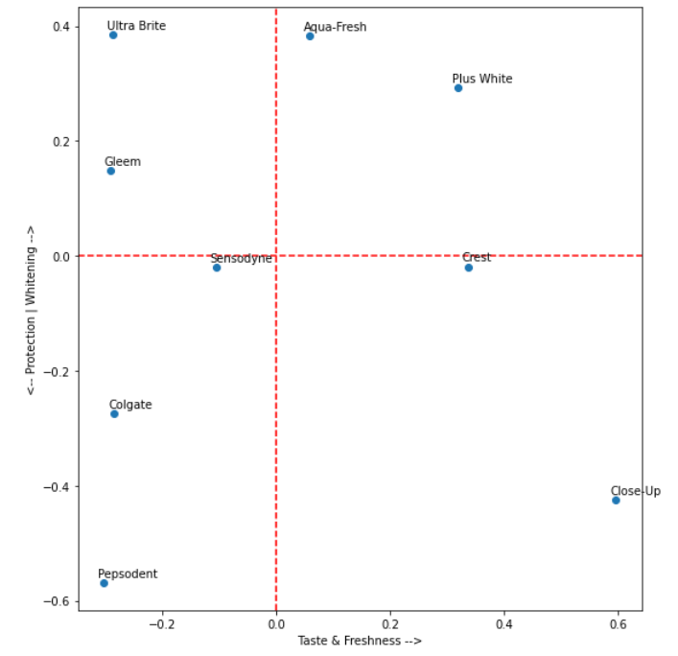
FINAL INSIGHTS/ RECOMMENDATIONS
On running our model, we get the below plot where different brands of toothpastes are placed at different positions.
In order to make meaningful insights from the plot, we can name our X and Y axes to identify and divide positioning of different brands.

Slide 13
FINAL INSIGHTS/RECOMMENDATIONS
In order to identify similar brands and group them together, we can use various techniques to identify clusters of similar or dissimilar brands and this would require general knowledge about toothpaste brands and their positioning in the market.
There are different types of toothpastes and the components in each toothpaste is different. Different companies manufacture variety of toothpastes depending on which customer segment they want to target.
Apart from various mix of products that companies manufacture, there is generally a particular USP for each brand, say Sensodyne, which is widely known for its toothpaste that helps in tackling teeth sensitivity.
Please find different types of toothpastes and their unique ingredient in next slide.

Slide 14
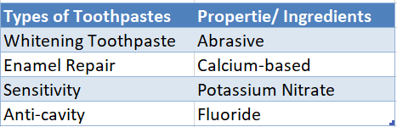
FINAL INSIGHTS/ RECOMMENDATIONS
From the plot obtained earlier, we can see that:
Brands like Ultra Brite, Gleem, and Plus White position themselves as Whitening toothpaste.
Close-up position itself as a brand that focuses highly on freshness and is different from other brands.
Colgate position itself as a calcium-based toothpaste, thus facilitating in Enamel Repair.

Slide 15
FINAL INSIGHTS/RECOMMENDATIONS
The X-axis can be a function of Taste & Freshness where when we move from left to right on X-axis, we move towards the brand of toothpastes which are positioning themselves heavily on Taste & Freshness in the market. This is their Unique Selling Proposition (USP).
The Y-axis can be a function of Protection/Whitening where brands which are at the lower end of Y-axis are positioning their brand for Protection against cavities & Germs whereas brands at higher end of Y-axis are positioning themselves as Teeth Whitening brands. This is their Unique Selling Proposition (USP).
We can also look at the price of different brand of toothpastes and see if that is a differentiating factor. Please find attached the price/100gm of different toothpastes.

Slide 16
FINAL INSIGHTS/RECOMMENDATIONS
Brand | Price * | Quantity
Plus White | ₹ 1200 | 100g
Gleem | ₹ 1120 | 100g
Ultra Brite | ₹ 600 | 100g
Crest | ₹ 300 | 100g
Sensodyne | ₹ 210 | 100g
Aqua-Fresh | ₹ 150 | 100g
Colgate | ₹ 75 | 100g
Pepsodent | ₹ 62 | 100g
Close-Up | ₹ 45 | 100g

Slide 17
FINAL INSIGHTS/RECOMMENDATIONS
From the prices, we can infer that as we move from top to bottom on Y- axis, the prices of toothpastes is decreasing. The values may differ and 1 or 2 brands may not follow the same pattern. But out of the total 9 brands, we can see that 6-7 are in place which is corroborated by the price table obtained in the previous slide.

Slide 18

THANK YOU

